Slide 1
Data Warehouse
Tushar Goyal

Slide 2
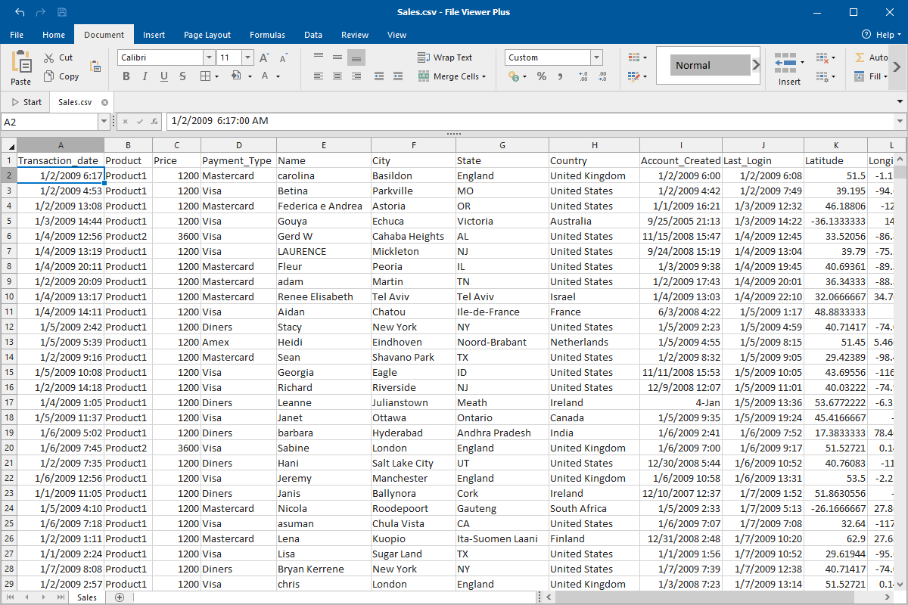

Slide 3
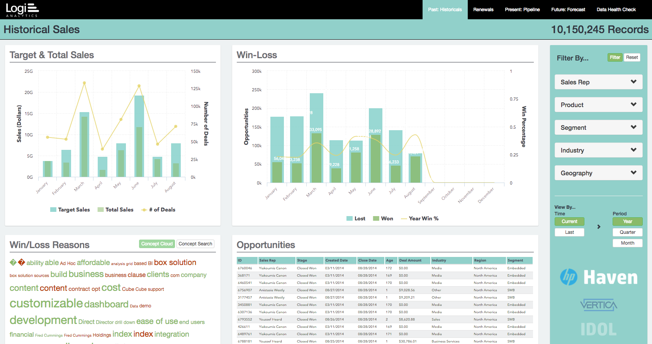

Slide 4
Why BI and Data Warehouse?

Slide 5
What is BI?
Relevant and reliable information to the right people at right time

Slide 6
Bussiness Intelligence
Performance Management
Analysis
Predictive Modeling
Data & text mining
And lot more…..

Slide 7
Most common example
Like a Grocery store
All things are managed

Slide 8
Terms
BI - who is interacting with company
Viz - Visualization
Ad-hoc Query [Ans for particular problem]
Data Broker [collect info and sell to other]
Multipolar Analysis [Data collected and analysed at several location]
Report
Dashboard
Data Warehouse

Slide 9
Most common example
Like a Grocery store
All things are managed
https://public.tableau.com/en-us/gallery/lego-evolution

Slide 10
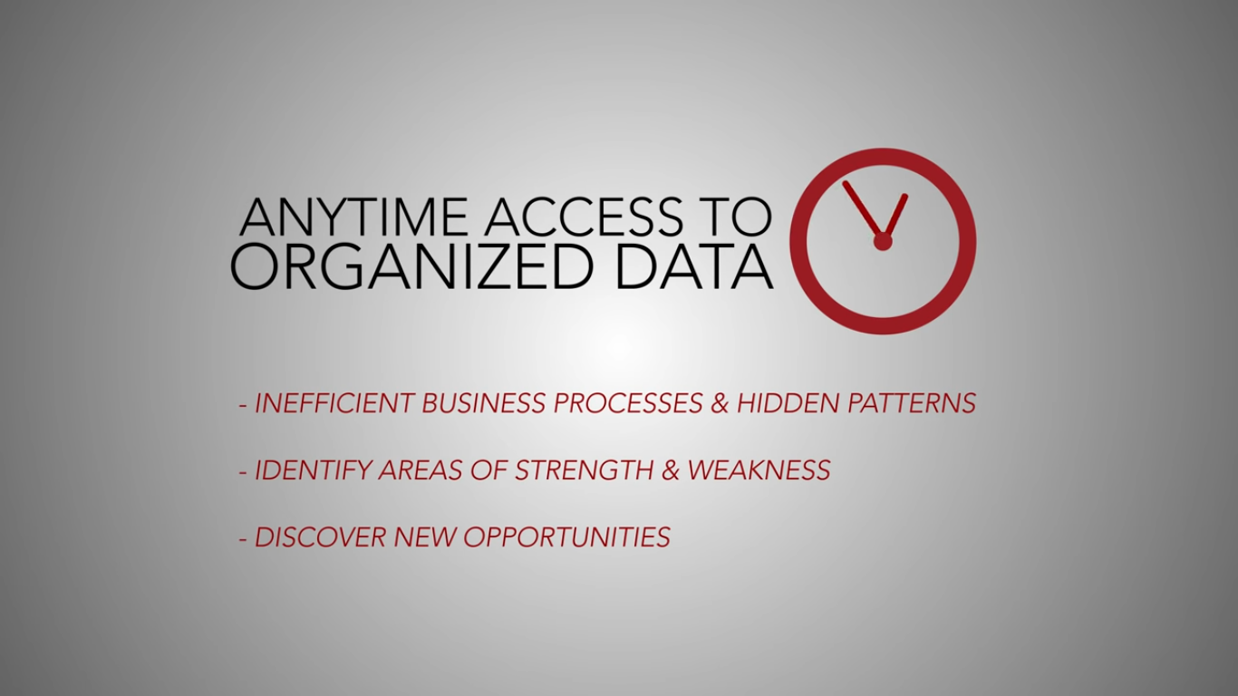
Advantages
Inefficinet

Slide 11
Components of BI
Data Source
Data Warehouse
OLAP
Advanced Analytics [Certain products]
Real time BI

Slide 12
Benefits of BI
Business intelligence is faster more accurate process of reporting critical information.
Efficient decision-making process.
Timely information for better customer relationship management.
Profit of company
Assessing organization’s readiness in meeting new business challenges.
Best practices and identifies every hidden cost.

Slide 13
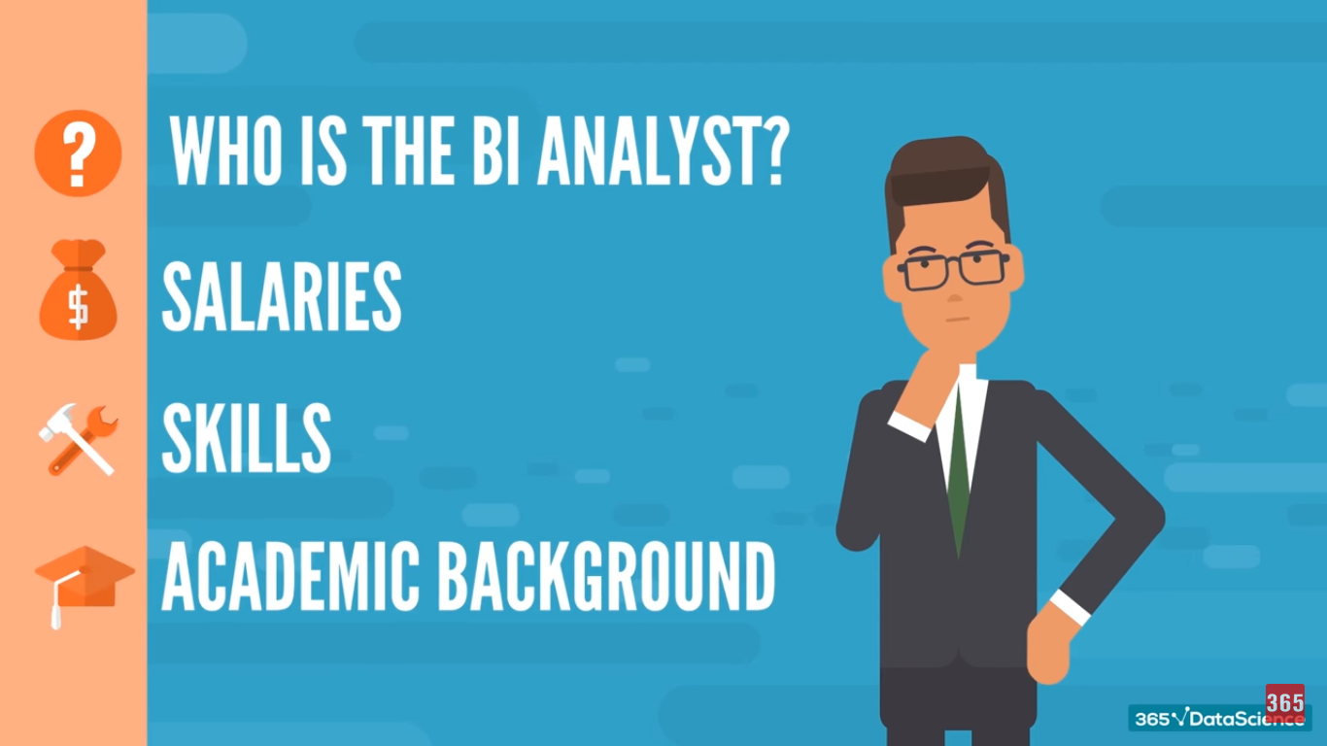

Slide 14
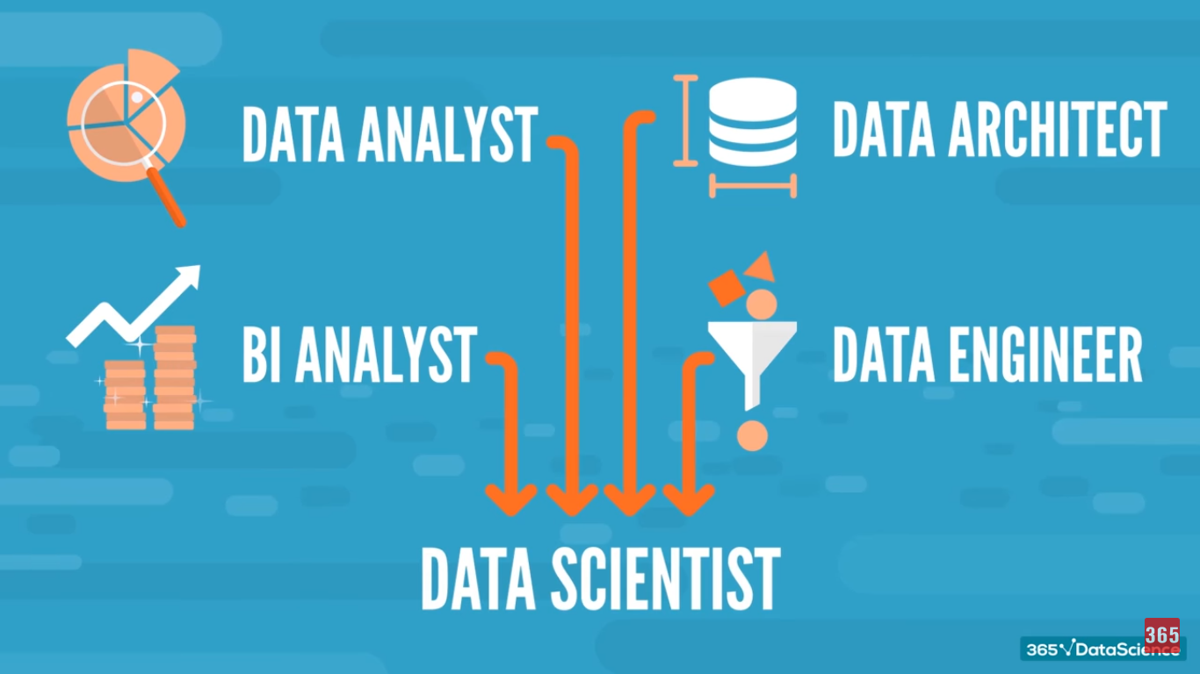

Slide 15

Mai Ninja Hattori

Slide 16
Some Work
Key Performance Indicators [KPI’s]
Overview of Business Performance
Where to do improvements

Slide 17
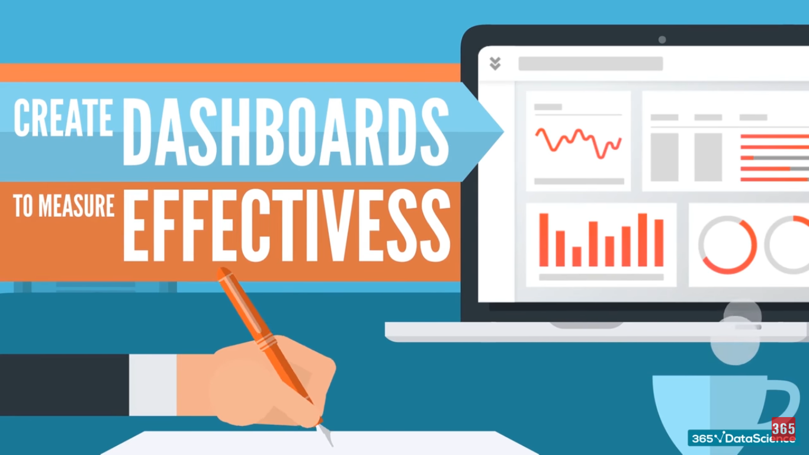

Slide 18
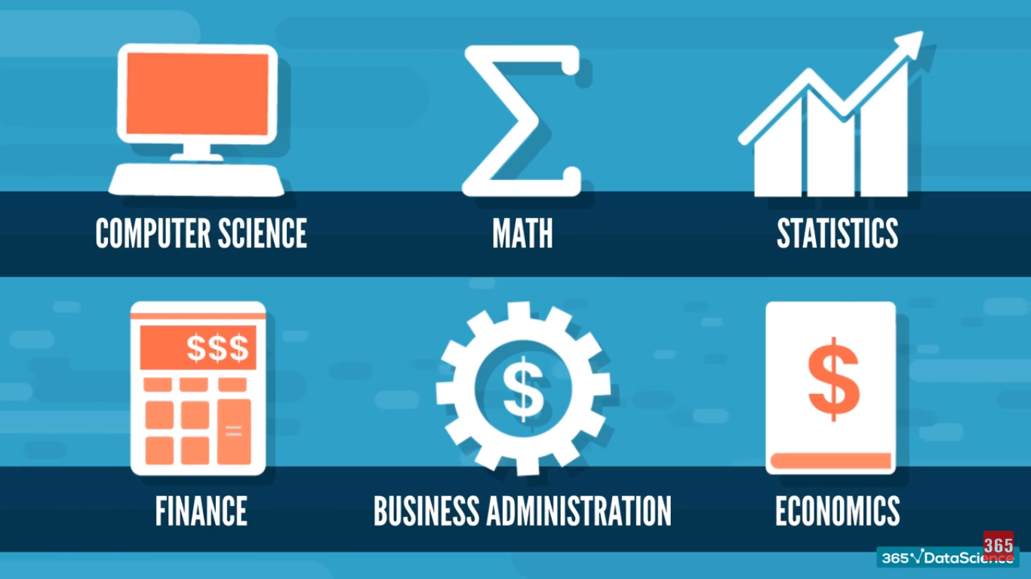

Slide 19
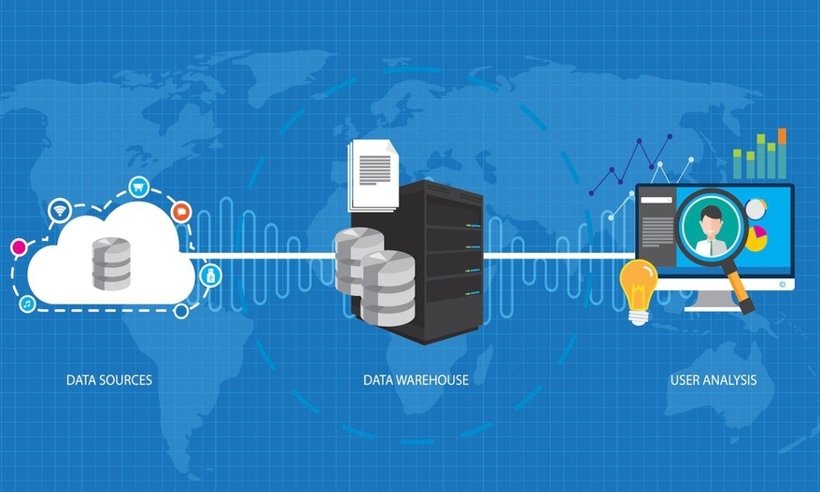
What is DWH?
Central location where consolidate data are stored from several location
DWH is maintained separately
End user access it
More accurate and is faster
Misconception : Not a product, it
needs to be designed

Slide 20
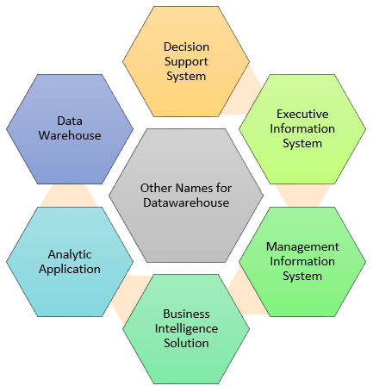

Slide 21
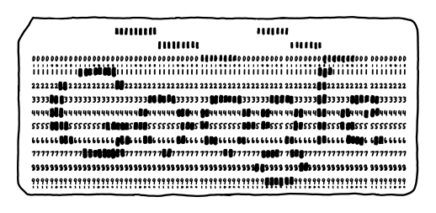
History
Punch card was used fast for data storage

Slide 22
History in detail
1960- Dartmouth and General Mills in a joint research project, develop the terms dimensions and facts.
1970- A Nielsen and IRI introduces dimensional data marts for retail sales.
1983- Tera Data Corporation introduces a database management system which is specifically designed for decision support
Data warehousing started in the late 1980s when IBM worker Paul Murphy and Barry Devlin developed the Business Data Warehouse.

Slide 23
Types of DHW
Enterprise :
Centralized warehouse
It provides decision support service across the enterprise
Operational :
Also called ODS
Used for case like storing Employees data, in which data is updated at real time
Data Mart:
Subset of Data Warehouse
Subject oriented

Slide 24
Components of DWH
Load Manager:
Performs with all the operations associated with the extraction and load of data into the warehouse.
Warehouse:
Warehouse manager performs operations associated with the management of the data in the warehouse
Operation like analysis of data for views , generation, transformation
Query Manager:
Management of Queries, schedule the query execution
End-user access tools:
Data reporting, Query, App development , EIS, OLAP tools

Slide 25
Properties of DWH
Subject Oriented [Particular trend / case]
Integrated
Time-variant [Data is stored in snapshots]
Non - Volatile [typically updated]

Slide 26
Architecture of DWH

Slide 27
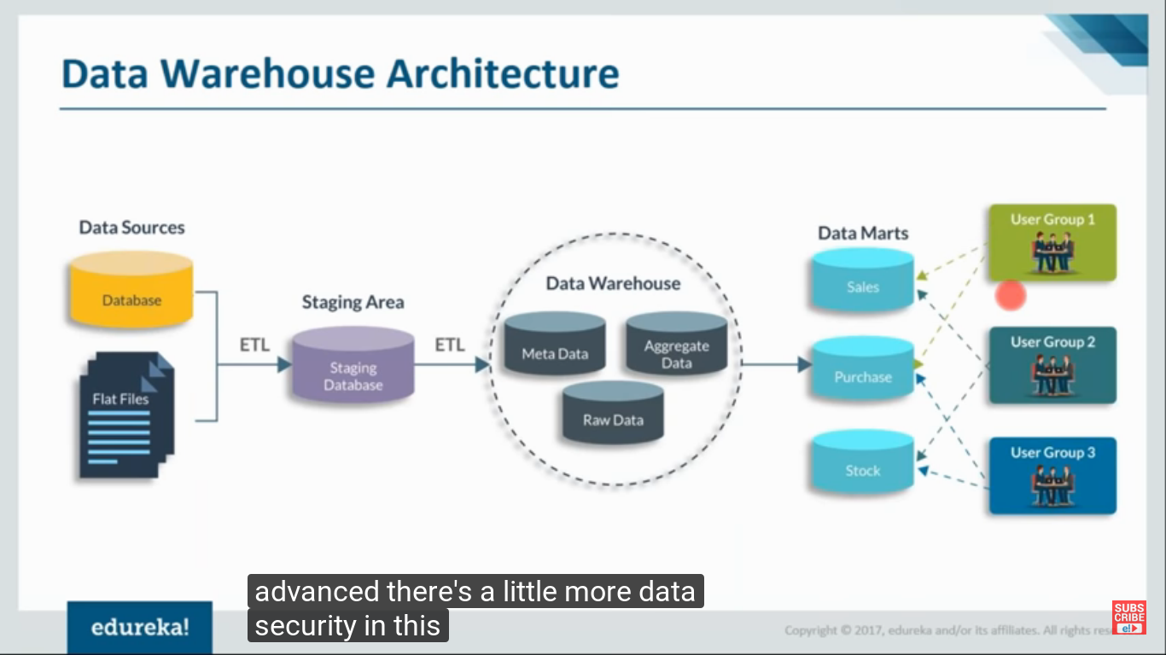

Slide 28
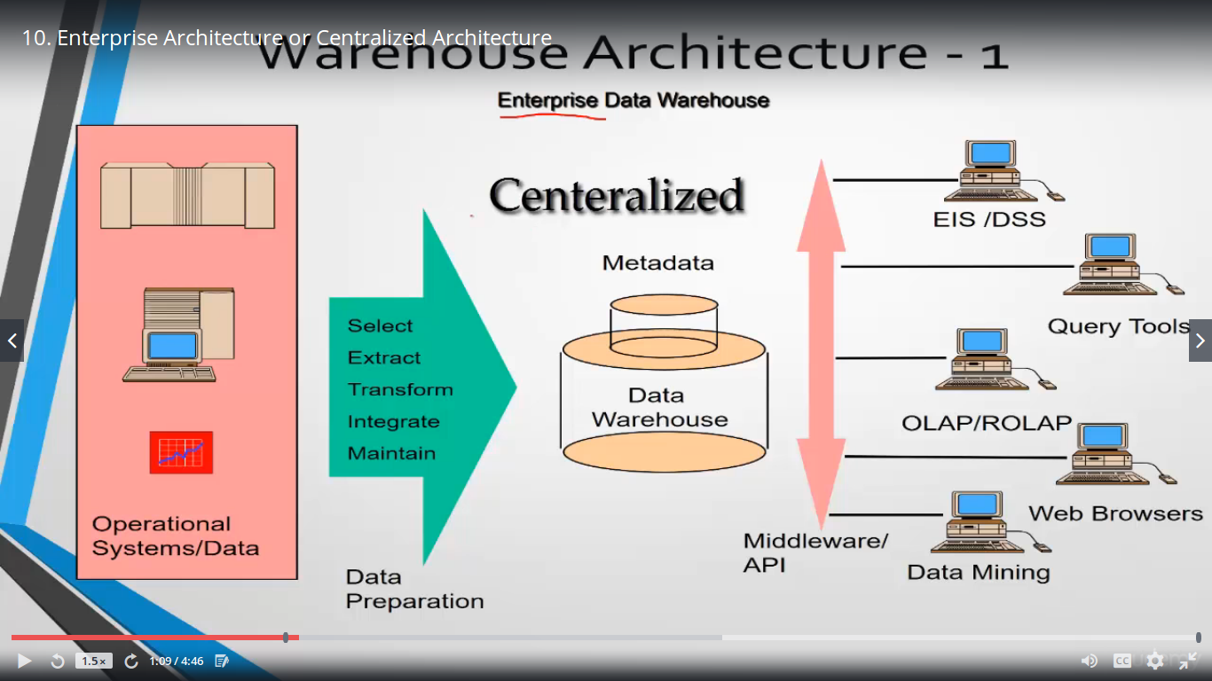
Architecture 1

Slide 29
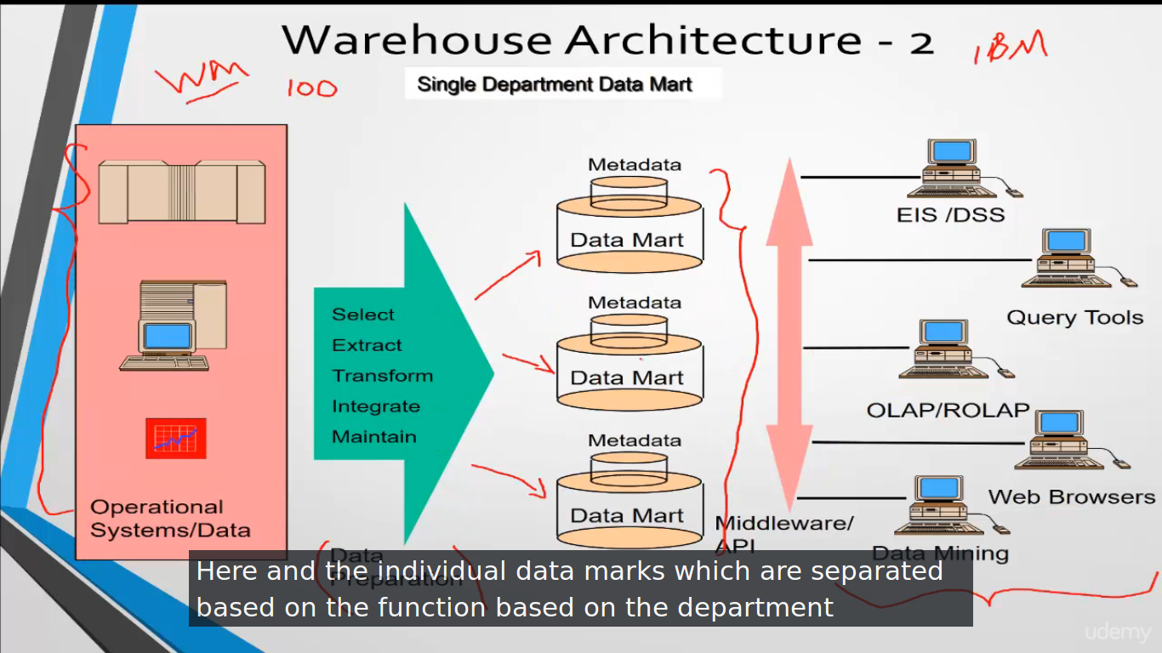

Slide 30
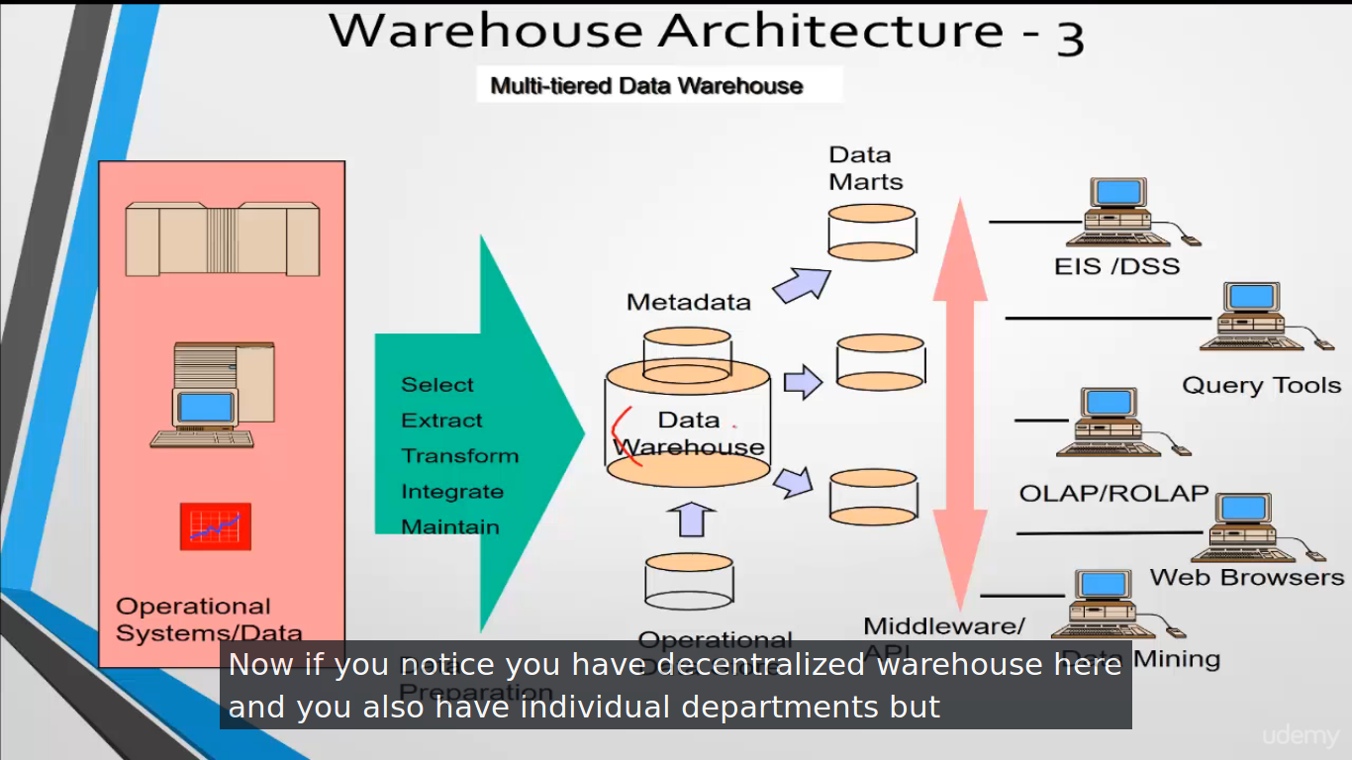

Slide 31
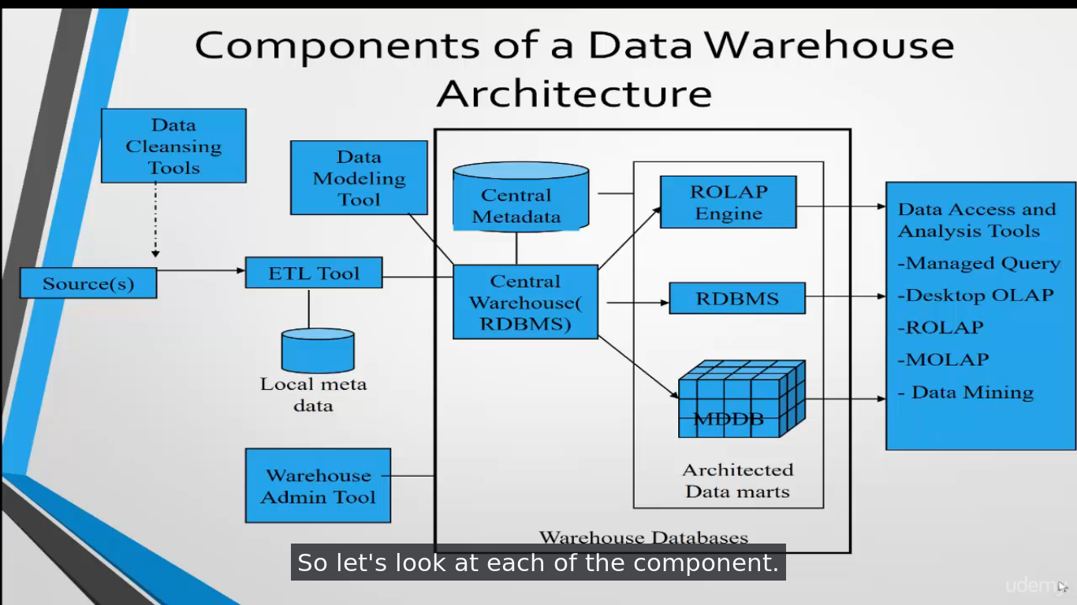

Slide 32
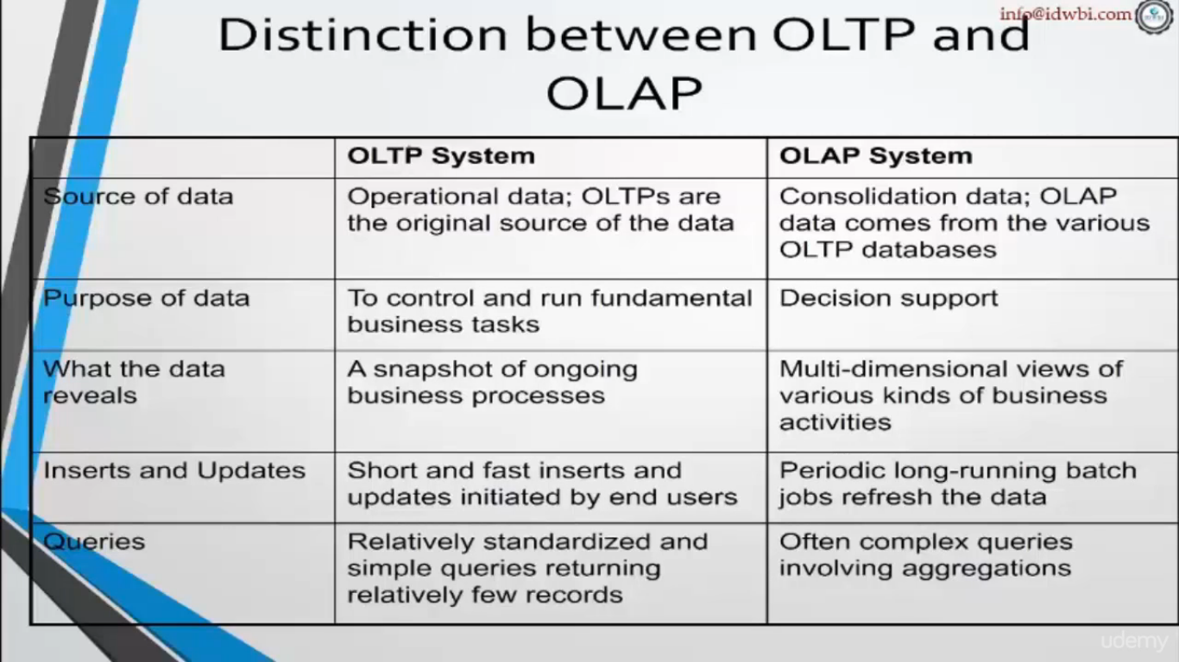

Slide 33
What is OLAP?
OLAP is flexible way to do complicate analysis of multidimensional data
Data warehouse are modeled on concept of OLAP

Slide 34
ADV of OLAP
NEW views of data stored in OLAP, as data is present in multi view.
Support filtering or sorting of data
Data can be refined

Slide 35
Type of OLAP cubes
Cubes are basically the type data will be stored
MOLAP - Multi-Dimensional OLAP Cube
ROLAP - Relational OLAP cube
HOLAP - Hybrid OLAP Cube

Slide 36
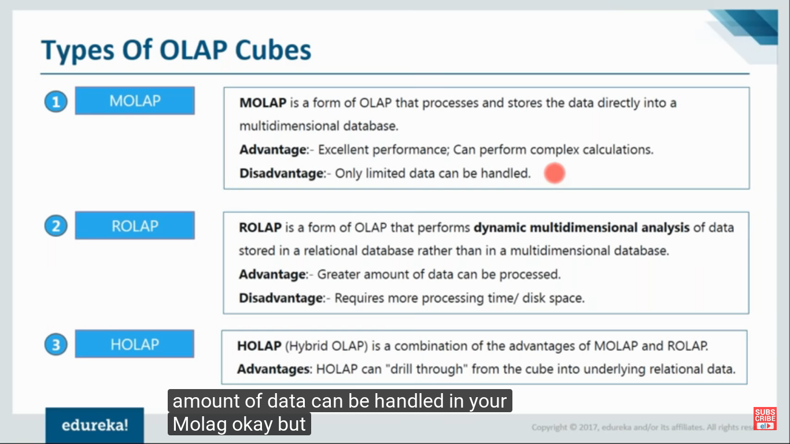

Slide 37
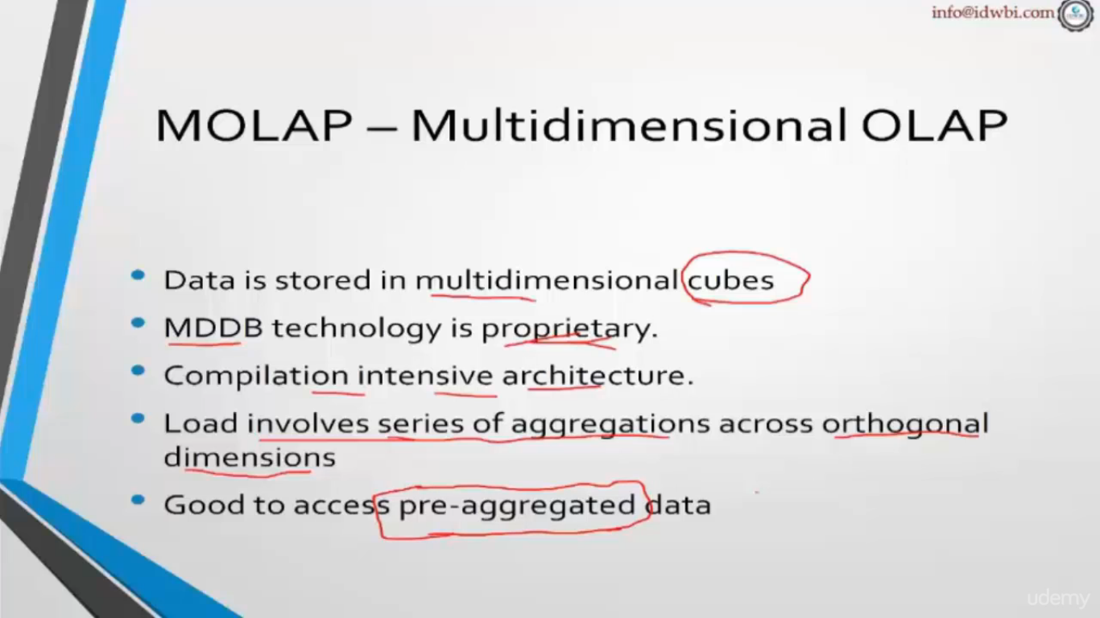

Slide 38
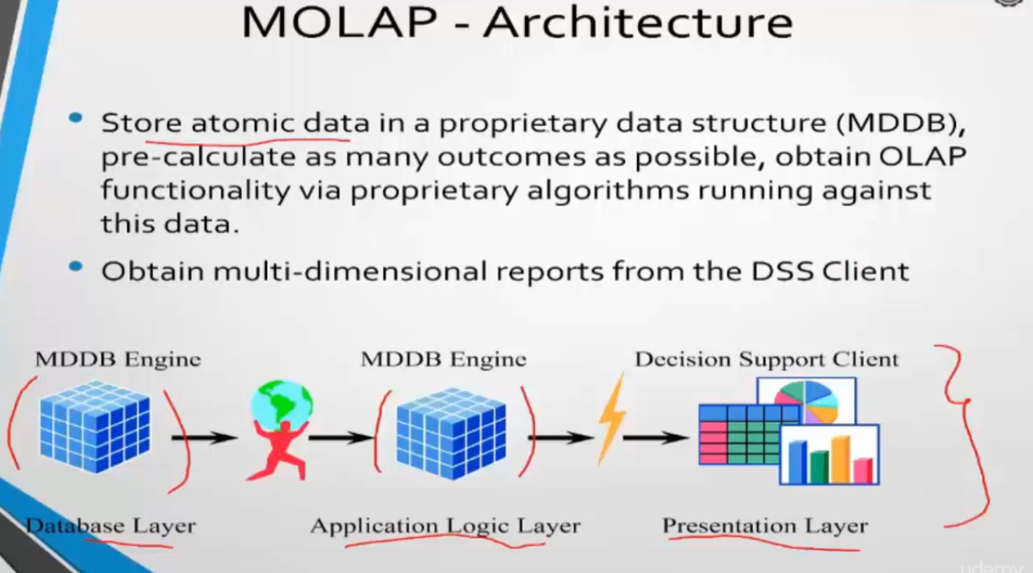

Slide 39
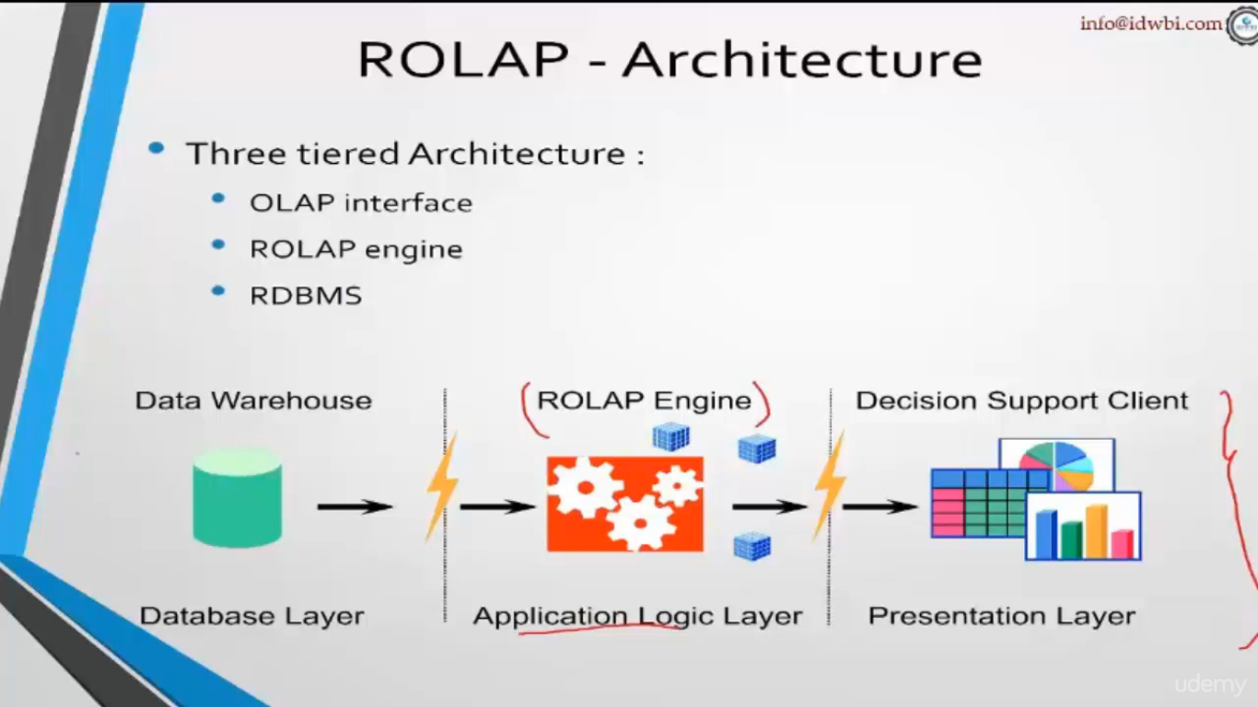

Slide 40
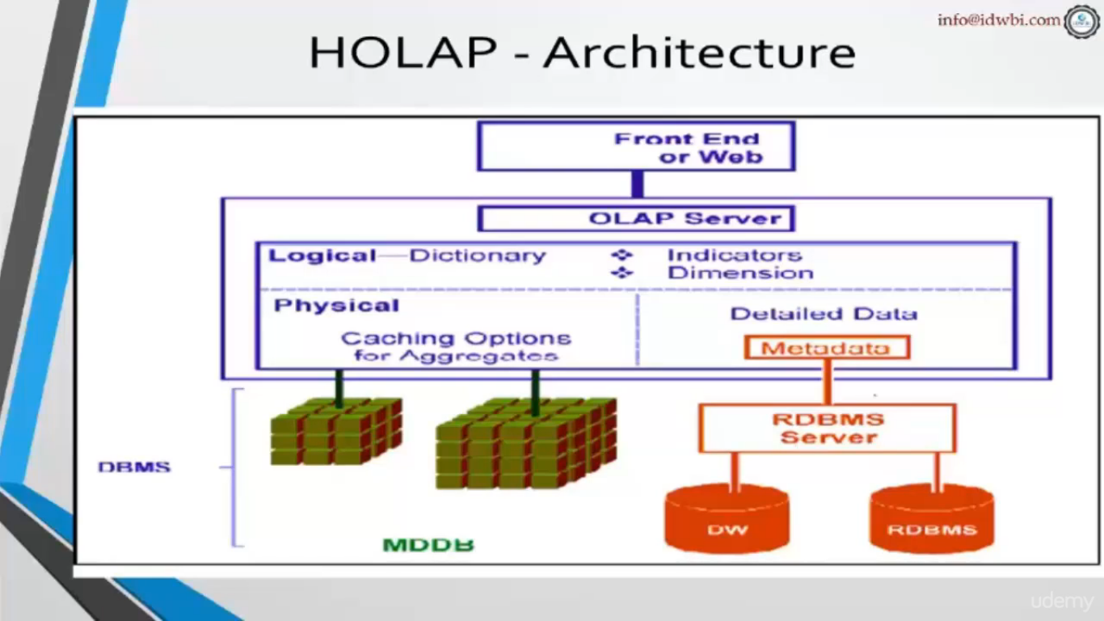

Slide 41
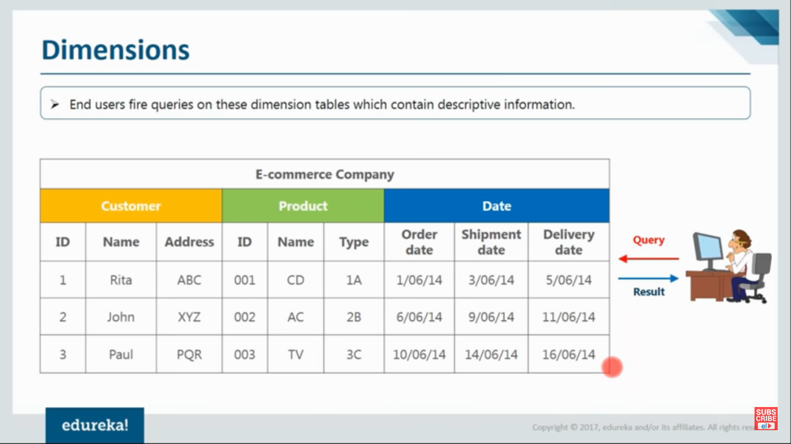
Dimensions
Provide structured information for analysis
Table describes the dimensions are called dimension Table

Slide 42
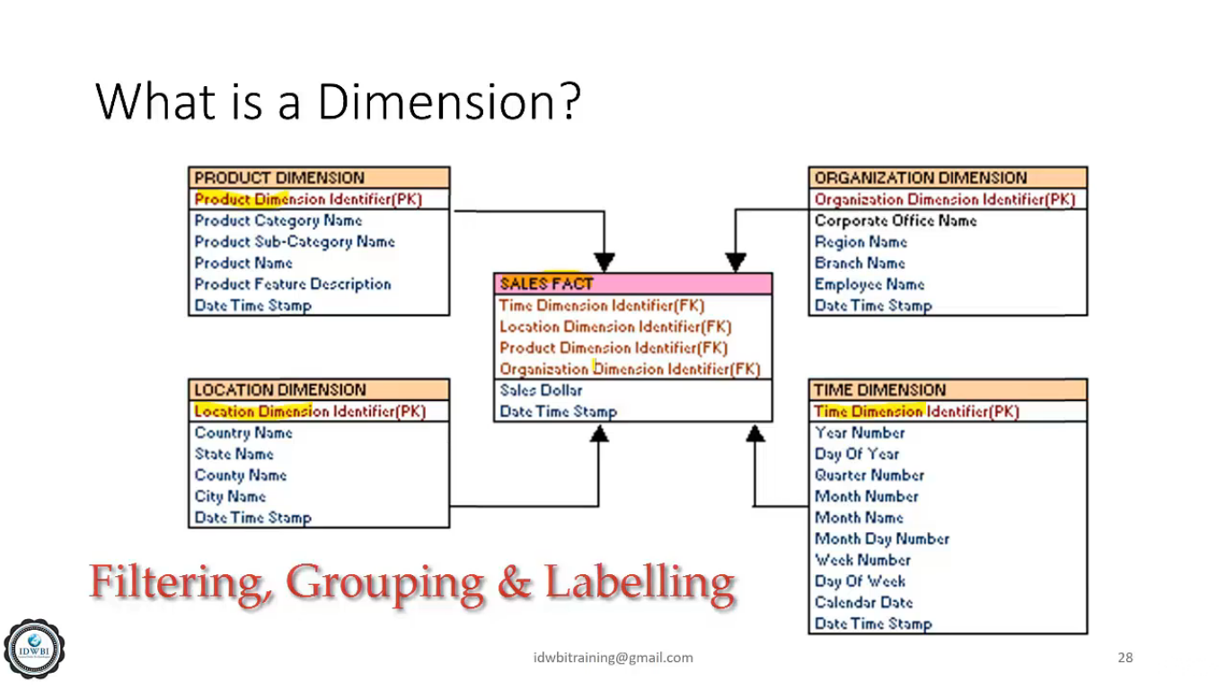

Slide 43
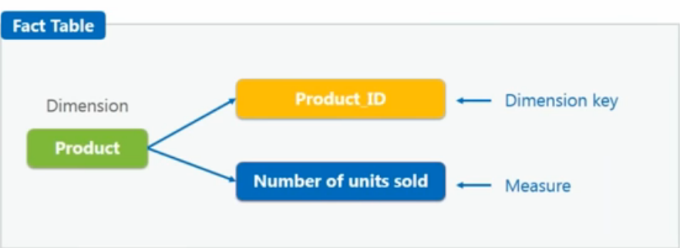
Facts & Measures
Its a measure that can be summed, average or manipulated
It has dimension key & measure
Every dimension table is linked with fact table
Can have duplicate values

Slide 44
SCHEMA
Gives logical description of entire database
Also give about constraints or linked between tables
Data Warehouse uses
Star
Snowflake
Fact Constellation

Slide 45
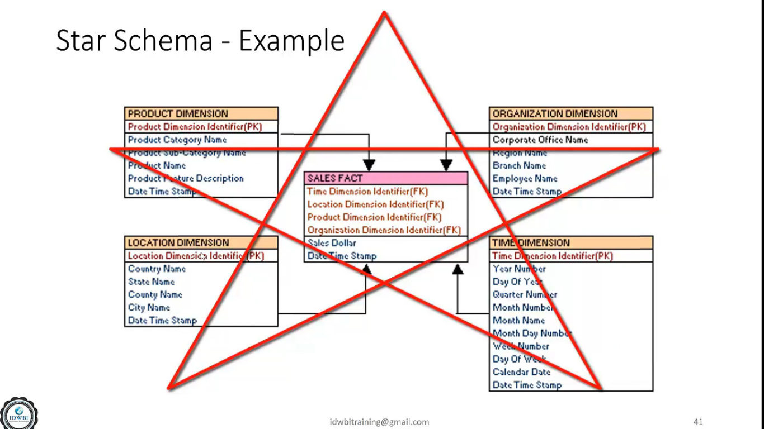

Slide 46
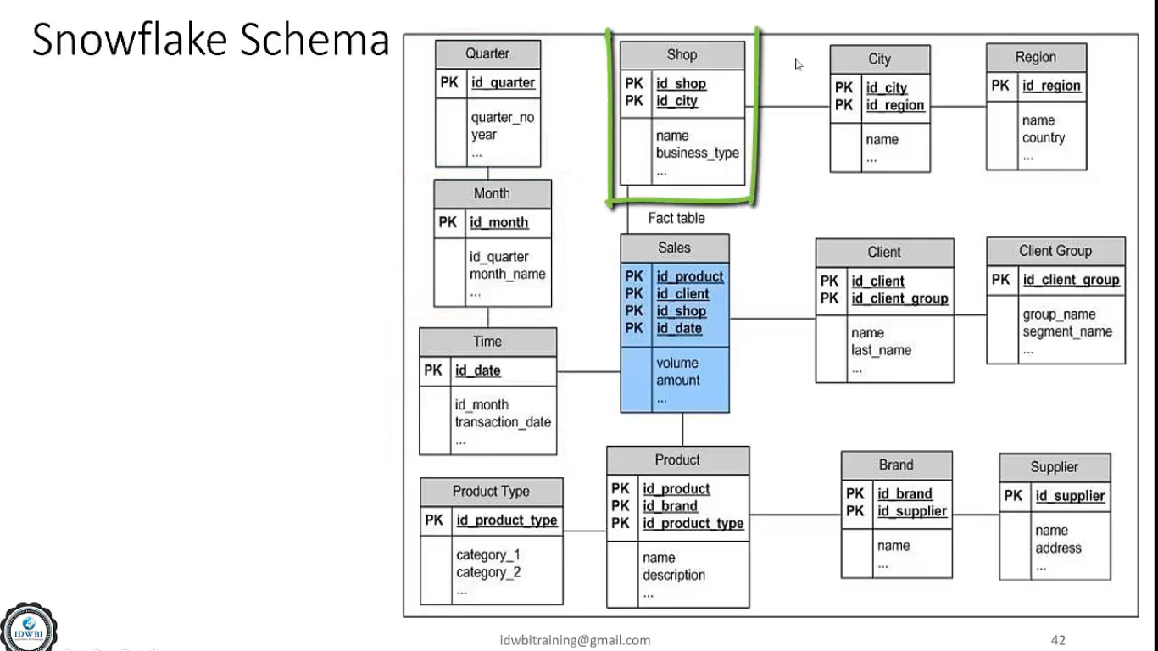

Slide 47
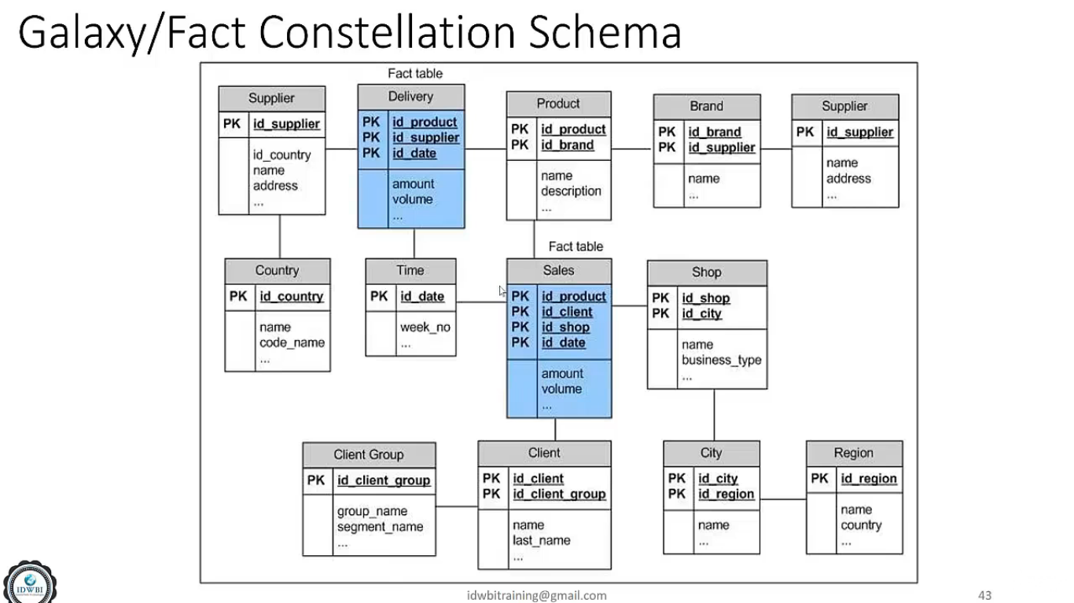

Slide 48
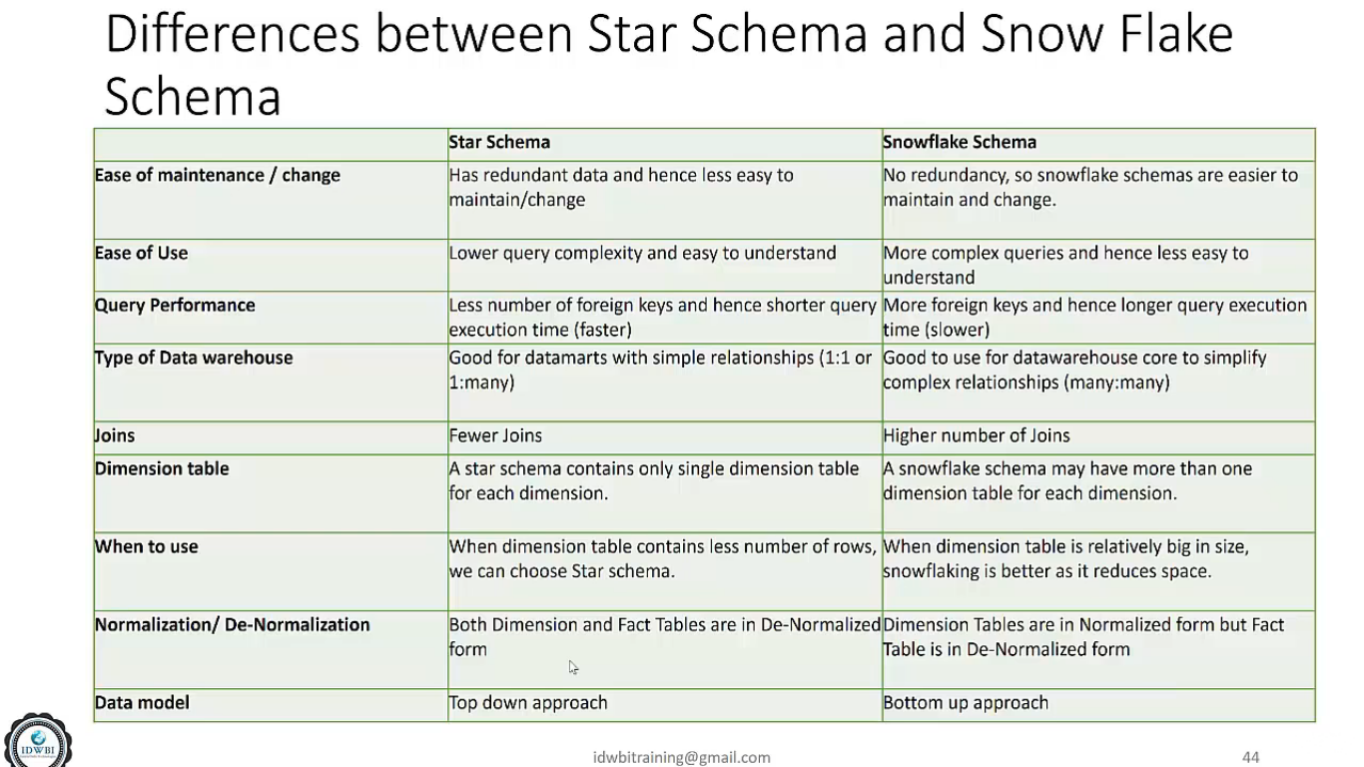

Slide 49
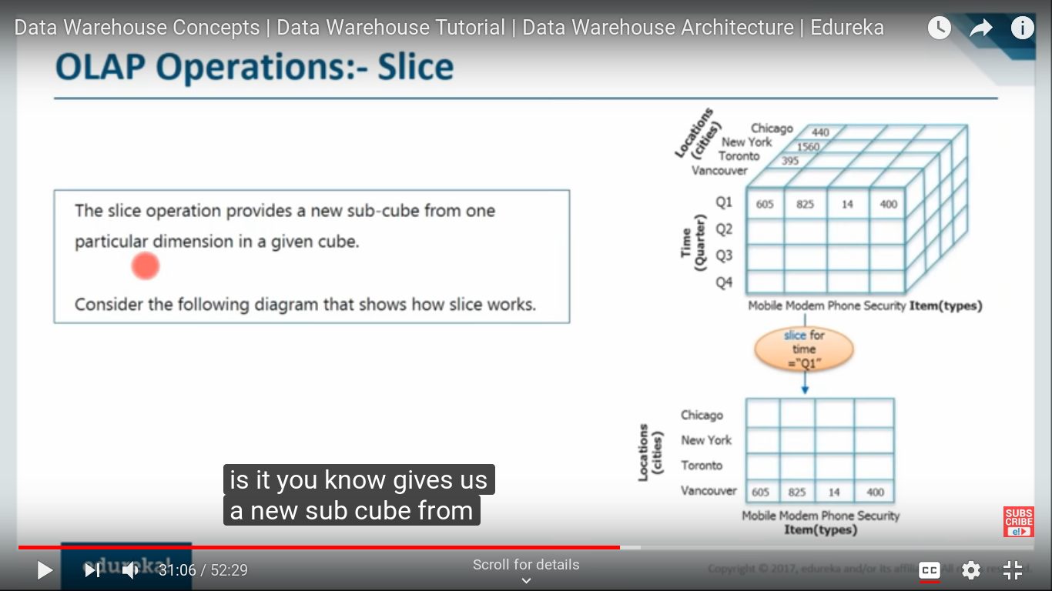
OLAP Operation
Roll-Up
Climbing up hierarchy of dimension - Reducing Dimension
Ex - Multiple cities to countries
Drill - Down
Introducing a new dimension
Quarter year to months or days
Slice
Get new sub-cube from 1 of the dimensions
Slice for time quarter q1 and getting cities

Slide 50
Examples:
OLTP:
Purchase at supermarket
Railway server records the transaction of passenger
OLAP:
How many customer are there and credit card user in bank
How many policy are issued

Slide 51
Data Mart
Smaller version of DWH
Deals with single subject
Data is drawn limited sources
Time taken to built is low
Prevent data access in DWH by all

Slide 52
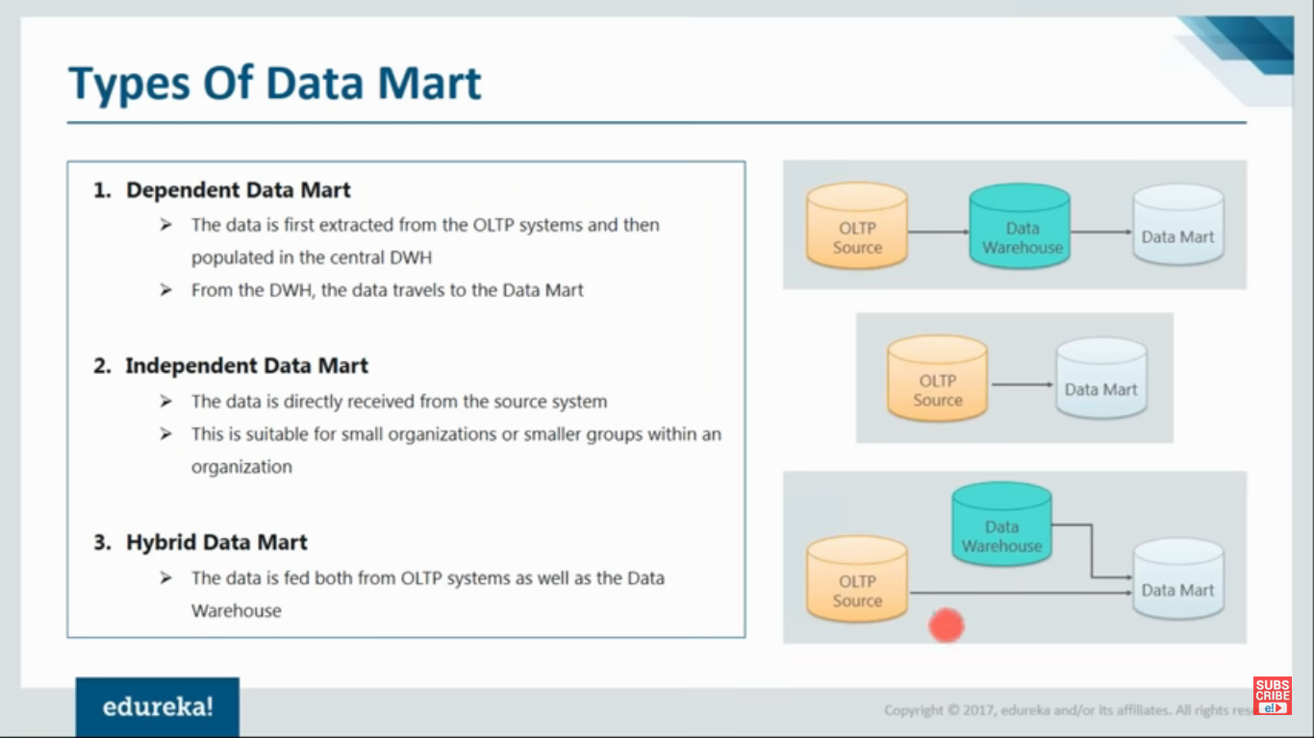

Slide 53
Best practices to implement DWH
Decide a plan to test the consistency, accuracy, and integrity of the data.
data warehouse must be well integrated, well defined and time stamped.
Stick to life-cycle, and ready for mistakes
Never replace operational systems and reports
No much time on ETL

Slide 54
Adv of DWH
access critical data from some sources all in one place.
Support Ad-hoc Query
Less stress on system
Less time to retrive data from multiple source and analysis

Slide 55
Disadv of DWH
Not an ideal option for unstructured data.
Data Warehouse can be outdated relatively quickly
Difficult to make updates
High utilization of resources

Slide 56


